Slide 1
US Beer Trend
Case Study 1| MSDS 6306| Y. Leung | K. Richardson

Slide 2
Project Scope
Identify the total number of breweries within each state.
Determine the median alcohol by volume (ABV) and median bitterness (IBU) from each state.
Identify the State(s) with the highest ABV content beer.
5-point summary statistics (Mean, Min, Max and 1st & 3rd quartile) of ABV along with median and number of missing values (N/A).
Identify a potential linear trend between ABV and IBU.
-The case study used and combined 2 data sets Beers.csv and Breweries.csv in order to perform the calculations within the project scope.

Slide 3
Project Goal
Determine if bitterness in beer is associated with alcohol by volume content in the US.
Produce the type of beer with high alcohol content but perhaps low in bitterness.

Slide 4
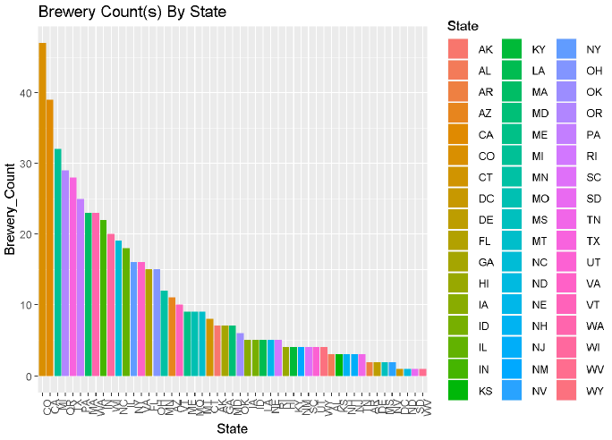
Breweries Per State

Slide 5
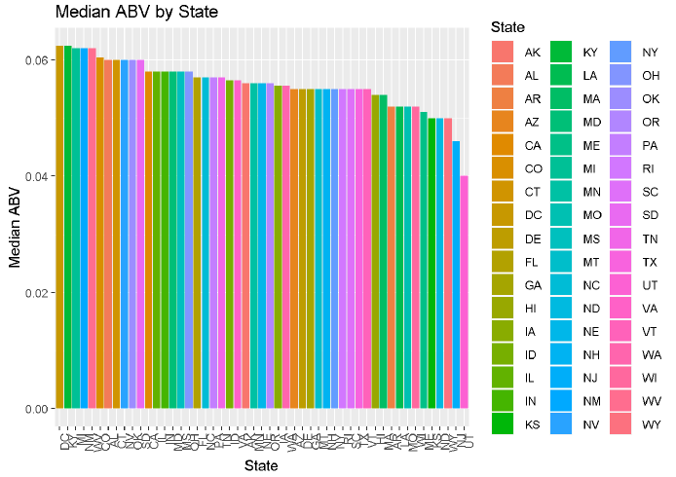
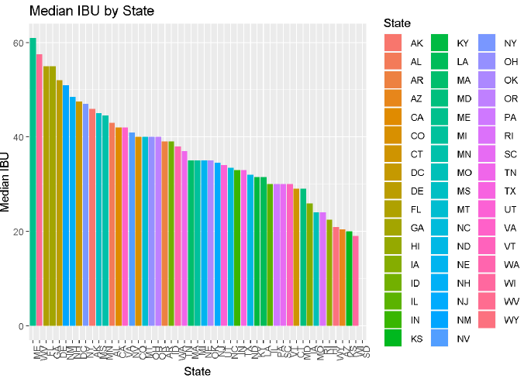
Median ABV & IBU in descending order
-Note: Beer from DC has the highest median ABV with Utah has the lowest.
-Note: In median IBU versus State, there was no value associated with SD. Maine has the bitterest beer and Wisconsin has the lowest median IBU.

Slide 6
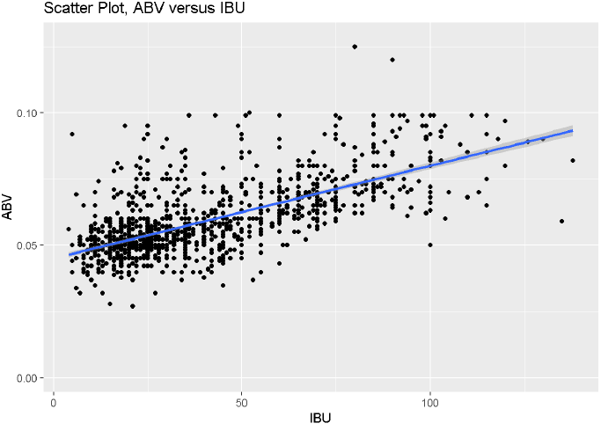
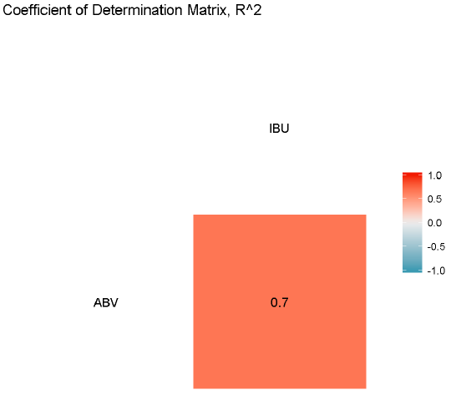
Linear trend between IBU and ABV
-Scatter plot between ABV vs IBU, majority of the data points were concentrated 10-30 IBU with the corresponding ABV between 0.03 to 0.06 ABV. A correlation matrix plot on the right showed that coefficient of determination (R²) of 0.7 or 70% of the response variable variation that is explained by the linear model

